Slide 1

Postman

Slide 2
What is a Postman?
Postman is a popular API client that makes it easy for developers to create, share, test and document APIs. This is done by allowing users to create and save simple and complex HTTP/s requests, as well as read their responses. The result - more efficient and less tedious work.

Slide 3
Why should you use Postman?
Accessibility
Use of Collections
Creating Environments
Creation of Tests
Automation Testing

Slide 4
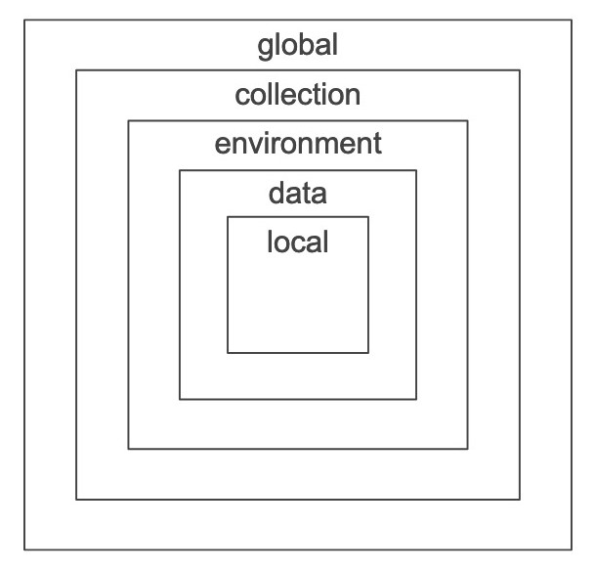
Using variables

Slide 5
Let’s go practice

Slide 6
Use Postman Echo for testing
https://www.postman.com/postman/workspace/published-postman-templates/documentation/631643-f695cab7-6878-eb55-7943-ad88e1ccfd65?ctx=documentation

